Slide 1
Using the physical features of chemical compounds to predict inhibition potential
By Abolaji Shiwoku

Slide 2
Background
Current practice in drug manufacturing depends mostly on a scientist’'s past experiment knowledge to develop a viable drug candidate
This process can cost > $10 billion, and 15+ years to bring a drug to market
Over the years, pharmaceutical companies have accumulated valuable data on past compounds that they considered for drugs, and use the data to inform on new compounds.

Slide 3
QSAR Model Description
QSAR models are a machine learning application that use a library of chemical compounds to predict a biological activity. The model can utilise the compound’s physical/ topological features (1D, 2D descriptors) or more complex descriptors (3D,4D,5D)

Slide 4
These descriptors are used to compute the desired biological activity. Recent QSAR models have been constructed using linear based models, mostly Logistic Regression and Simple Linear Regression. In certain situations, Random forest models can be utilised, or rare situations, deep learning via neural networks may be utilised.

Slide 5
Problem Statement
Construct a QSAR model that utilises derived physical features of chemical compounds to predict the inhibition effect of the compound on target protein, Beta Secretase 1.

Slide 6
Beta Secretase 1
The main enzyme that is encoded by the BACE1 gene, and is expressed in human neurons.
Elevated levels of this enzyme has been linked to the development of Alzheimer's disease. The general belief is that if a drug could inhibit this gene, then the enzyme would not be manufactured by the body, and the disease will cease to afflict the patient.

Slide 7
Dataset
We have access to a public database, CHEMBL which has a library of over 9000 tested compounds that have been tested on their ability to inhibit BACE1.

Slide 8
Molecular Descriptors
We will use molecular descriptors that describe the physical and topological structure (1D and 2D) of the compound to predict whether the compound will provide good inhibition of the gene.
The molecular descriptors will be calculated using PaDel Software, a open source cheminformatics tool that provides access to a wide range of descriptors that one many need.

Slide 9
Preparing Chemical Library
Before allowing our model to learn a chemical compound’s, we must make sure that the compound has good potential to administer for a drug manufacturing. That is why we make sure every compound follows the Lipinski’s Rule of Five. This means none of the compounds can violate more than one of these rule:
> 5 Hydrogen Bond Donors
>5 Hydrogen Bond Acceptors
<500 daltons for molecular mass weight
>5 (logP) octanol-water partition coefficient

Slide 10
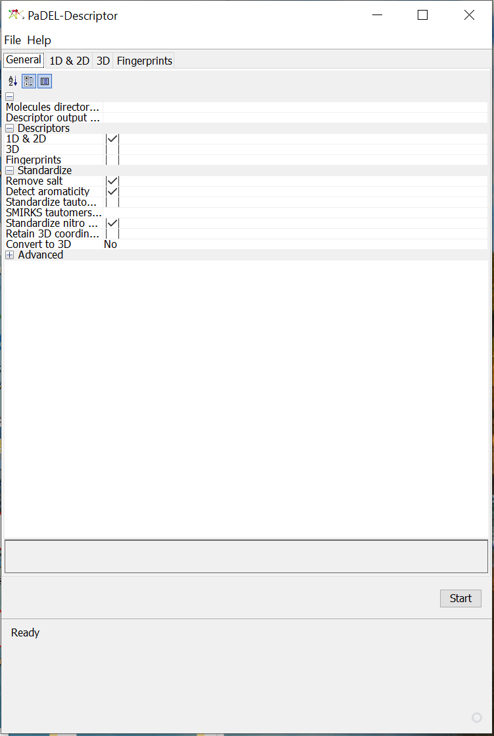
Molecular Descriptor Calculation
(Feature Engineering)
For each compound selected to train our model, the third party software, PaDel, was used to calculate the molecular descriptors. The initial data set contained over 350 calculated features.

Slide 11
Feature Selection
Due to the large number of features contained in our model,shrinking the number of model parameters makes explaining model functionality to others easier, and will reduce error of future predictions.
The feature selection process followed this format:
Remove features with little to no variance. These provide little information to the model in terms of predicting the dependent variable.
Discard features that display strong collinearity with other features. Features with high collinearity can lead to overfitting as they provide similar information repeatedly.
Utilize R’s wrapper function backward stepwise elimination using AIC criterion to choose optimal features. Backward stepwise returns the subset of features that optimizes the AIC, which penalizes large models that overfit the data.

Slide 12
Datasets
Two Model datasets were constructed:
Dataset for binary classification (“active” label for compounds that display inhibition effect, “inactive” label for those that don’t
Dataset for regression model - model will predict the exact value of the pIC50 value ( measure of inhibition)

Slide 13
Final Datasets
The final datasets were:
Skewed toward active proteins ( datasets contained ≈ 80- 85% active compounds)
Consisted of 35 features for regression and 34 features for classification
Rescalled using sklearn StandardScaler to standardize each individual feature

Slide 14
Models for Binary Classification
Logistic Regression
Random Forest
Support Vector Machine
Feed Forward Neural Network

Slide 15
Models for Regression
Support Vector Regression
Multivariate Linear Regression
Multivariate Linear Regression w/ Polynomial Coefficients
Feed Forward Neural Network

Slide 16
Metrics used for model evaluation
Classification model
Precision
Recall
Classification Report
Regression Model
RMSE (Root Mean Squared error)
Mean Absolute Error
Predicted vs Actual scatter plot
Adjusted R²

Slide 17
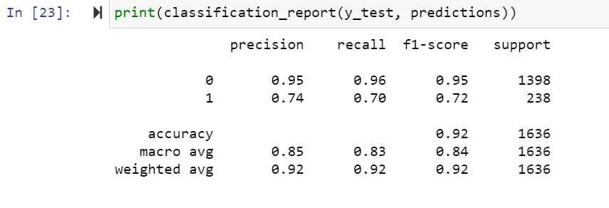
Model Results
The best classifier model was the RandomForest classifier. It showed exceptional performance on the active class, as well as respectable recall of the minority class. SMOTE analysis was also implemented during training to reduce the impact of class imbalance.
The classification report

Slide 18
Model Results
The best regression model was the Support Vector Regression. The hyper parameters were:
epsilon=0.1, C=0.6, kernel =rbf( Radial Basis Function)
The metrics used to monitor performance were mean absolute error (0.608) and root mean squared error (0.821). The downsides of this model is that, unlike a MLR model, the interpretability of the model is not quite as easy as a simple linear model.
What set this model apart from the other regression models was the performance on the test set.

Slide 19
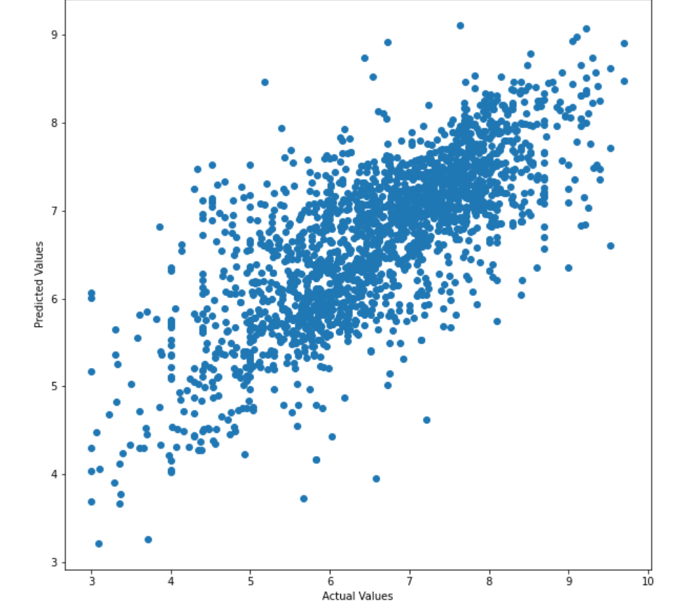
Actual vs Predicted plot

Slide 20
Future Model Improvements
Better feature selection - Better threshold application may yield subset of features that serve as better predictors.
Using original feature with no feature selection - perform model training using full model set may yield better results and provide robustness to predict affinity for other compounds
Include additional biological properties - Including additional biological activities, such as cardiotoxicity, could provide insight to possible side effects of certain

Slide 21
Next Steps
Build model into web app using Streamlit
Evaluate performance of model on new, unseen chemical dataset
Improve model metrics by revisiting feature engineering

Slide 22
Contact
I would love to hear feedback on how I could improve this project.
Email: abolajishiwoku@yahoo.com
LinkedIn: https://www.linkedin.com/in/abolaji-shiwoku-6b08361a3/
Github:

